Slide 1



EDUp FORDCS V1.0 Development
Vienna, April.2022
F
Compendium
FORDSC Project
Edu Platform
v2022.04
MSc. Ömer Karacan
karacankos@gmail.com

Slide 2
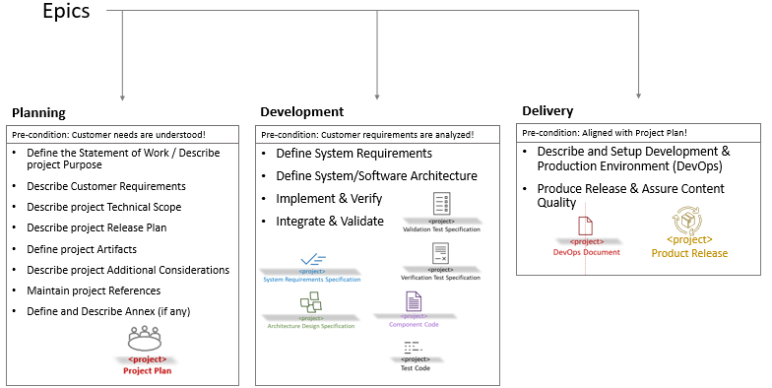
SwPD Method Epics - Setting
Source: EDUp-Full-Stack-Software-Project-Development-Method.pptx

Slide 3
Define System Requirements
see 2_EDUp FORDCS-V1.0 System Requirements.v2022.04.pptx

Slide 4
System/Software Architecture

Slide 6
Implement & Verify

Slide 8
Integrate & Validate

Slide 10
BACKYARD
BACKYARD

